Slide 1

Bangladesh University of Business and Technology
A Presentation on
Diabetes Prediction System
Using Machine Learning in web based application

Slide 2
Thank you to our
Supervisor
Mr. Sudipto Chaki
Assistant Professor Dept. of CSE, BUBT

Slide 3






Team : Diagon-Alley
Team Members
Md. Rashadul Islam
Md. Faysal Mahmud
Sadia sultana
Dipa Rani
Md. Sahal Kabir
Id: 19202103169
Id: 19202103174
Id: 19202103184
Id: 19202103201
Id: 17183103051

Slide 4
Content
Introduction……………………………. . [1]
Motivation …………………………….... [2]
Literature Review…………………….. [3 -4]
Contribution…………………………..... . [5]
Methodology…………………………….. [6]
Algorithms………………………………. [7]
Research Outcome………………………. [8]
Result Analysis …………………….. [9 - 19]
Contribution and Future Work ……….... [20]
Reference …………………………….. [21]

Slide 5
1
Introduction
Diabetes prediction system is a ML Model that uses patient data to predict Diabetes
This system uses various input variables, including age, BMI, blood pressure etc. to make predictions
The system can help doctors and patients identify potential diabetes risks early
With accurate predictions, the system can ultimately improve patient outcomes and reduce healthcare costs associated with diabetes management.

Slide 6
2
Motivation
To assist medical professionals
To help users to cross validate with medical data with help of ml

Slide 7

Literature Review
3
Jobeda Jamal Khanam et al. Proposed A comparison of machine learning Algorithm for diabetes Prediction system The major goal of the study is to data mining and machine learning approaches to predict diabetes in Patients To accomplish the above goals the research make use of Logistic Regression, support vector Machine, Decision Tree, k-Nearest Neighbors, Random forest, Naive Bayes and Adaptive Boosting. The Lacking's of the study is, it neglects Particular information about the Preparation Procedures used, such as outlier removal, handling missing value and normalizing.
Sanskruti Patel et al. proposed predicting a risk of diabetes at an early stage. using a machine learning approach. The major goal of the study is use machine learning technique to Create a Predictive model for early identification of diabetes to accomplish the above goals the research make use of Gaussian, Naive Bayes, Random Forest, Support Vector classifier, and Multinomial Naive Bayes The lacking of the study is, the paper doesn't address how this imbalance was handled during model training and evaluation, which can affect them.
[Khanam, J. J., & Foo, S. Y. (2021). A comparison of machine learning algorithms for diabetes prediction. Ict Express, 7(4), 432-439.]
[Patel, S. (2021). Predicting a risk of diabetes at early stage using machine learning approach. Turkish Journal of Computer and Mathematics Education (TURCOMAT), 12(10), 5277-5284.]

Slide 8
Literature Review
4
Jingyu Xuc et al. Preposed Diabetes Prediction Method Based on Machine Learning. The major goal of the study is to Performance comparison of several machine learning algorithms for diabetes prediction. To accomplish the above goals the research make use of SVM is used as a binary classification technique. The Naive Bayes classifier is used. Lacking's of the study is, The findings would be seen from a more unbiased view point if the limitations were discussed.
M.Rajeswari et al. Proposed Diabetes Prediction Using Machine Learning. The major goal of the study is to use machine learning to predict and identify diabetes. To accomplish the above goals the research make use of a variety of dataset including the Pima Indian diabetes dataset, different machine learning methods such as Decision tree, Naive Bayes, Support vector machine (SVM). Lacking of the study is, the performance of algorithms can be affected by factors like dataset size, features selection and preprocessing techniques
[Xue, J., Min, F., & Ma, F. (2020, November). Research on diabetes prediction method based on machine learning. In Journal of Physics: Conference Series (Vol. 1684, No. 1, p. 012062). IOP Publishing.]
[Rajeswari, M., & Prabhu, P. (2019). A review of diabetic prediction using machine learning techniques. International Journal of Engineering and Techniques, 5(4), 2395-1303.]

Slide 9

5
Contribution
Data Preprocessing
Ensemble Method
User Interaction

Slide 10
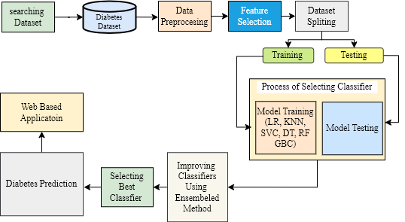
6
Methodology
Fig – Process workflow of Diabetes Prediction System

Slide 11
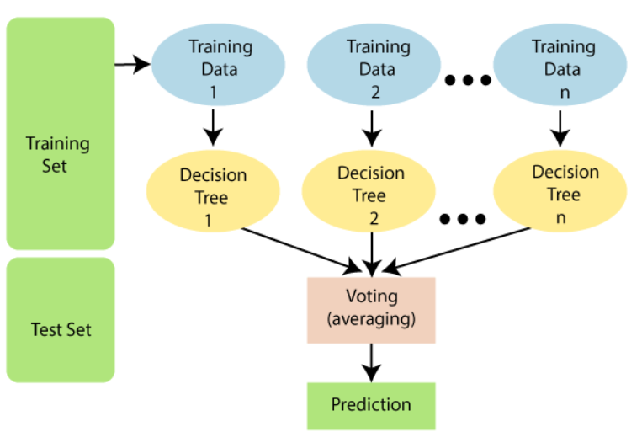
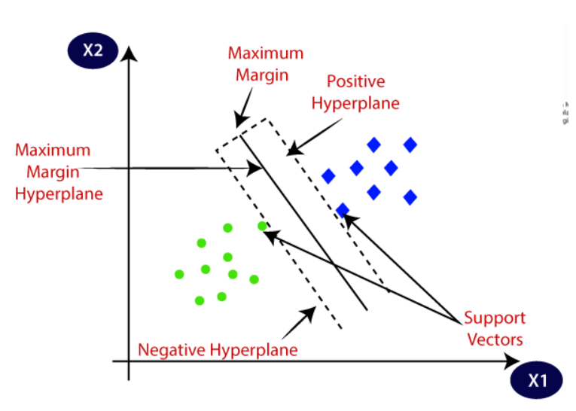
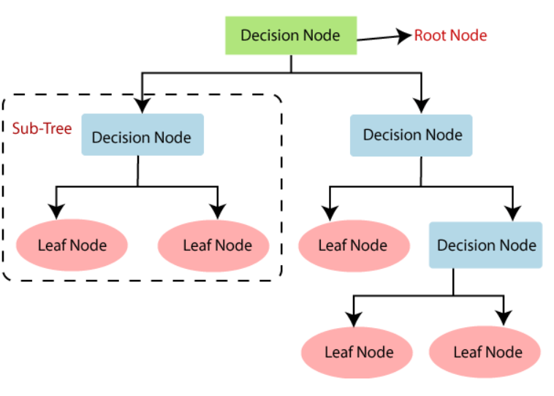
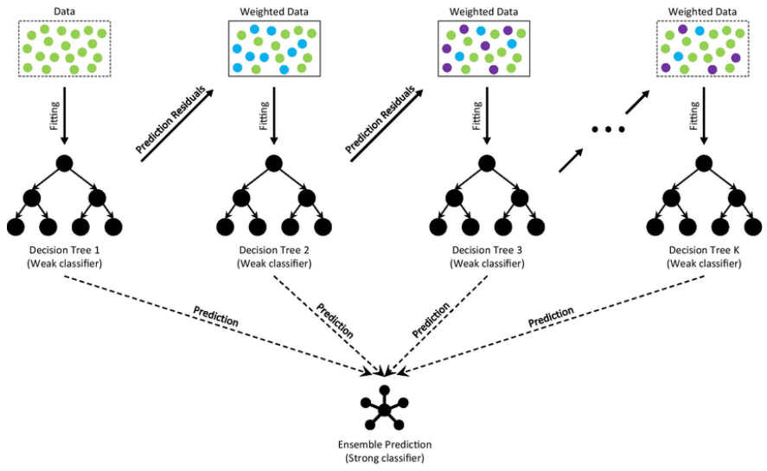
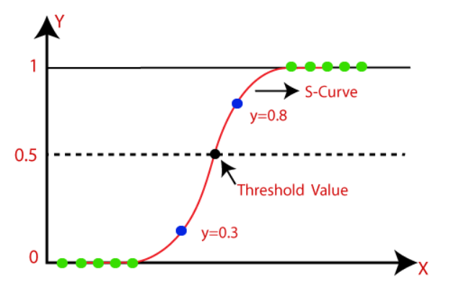
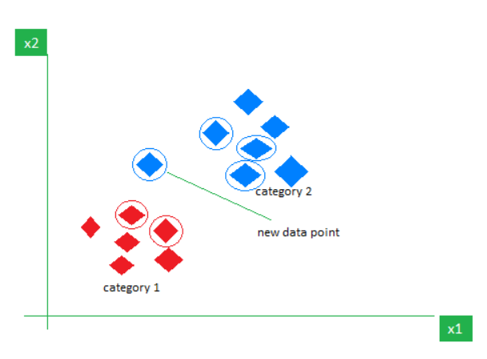
Algorithms
7
Fig – Random Forest
Fig – Support Vector Machine
Fig – Decision Tree
Fig – Gradient Boosting Classifier
Fig – Logistic Regression
Fig – k nearest neighbor

Slide 12
8
Research Outcome
We are not aiming to challenge medical professionals, our primarily focuses on providing users with the ability to independently verify their outcomes through an web based application.

Slide 13
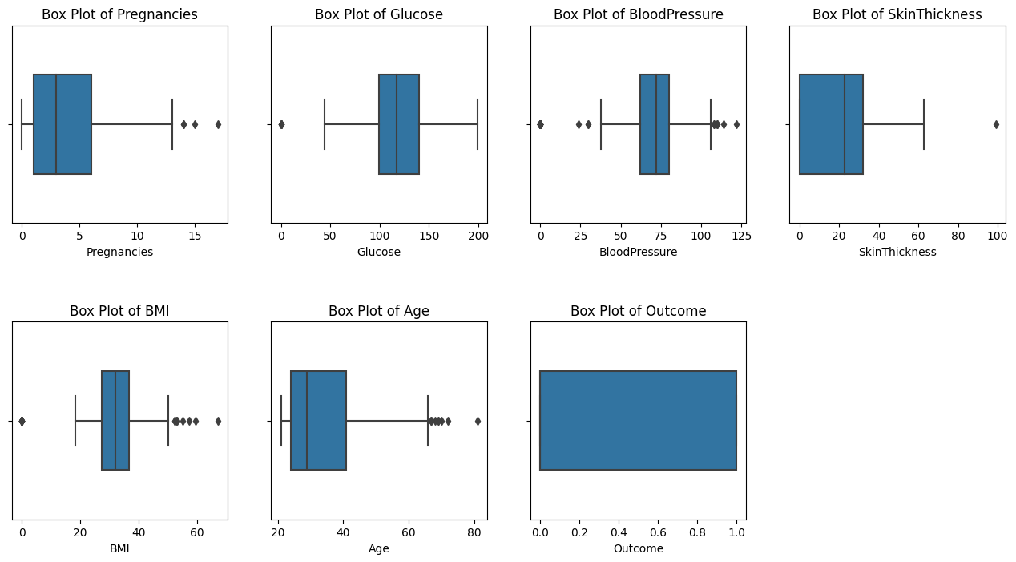
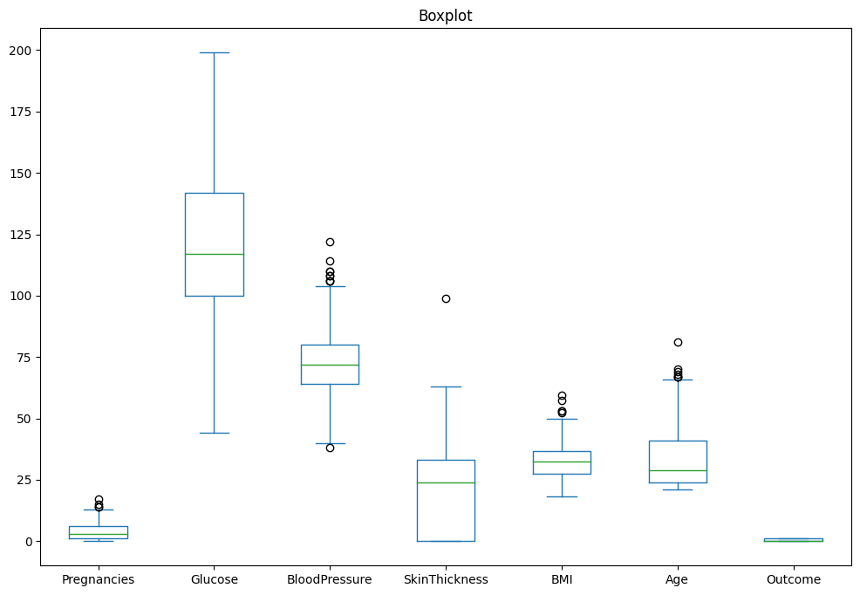
Result Analysis
9
1. Back-End:
Fig - Outlier Detect
Fig - Outlier Remove

Slide 14
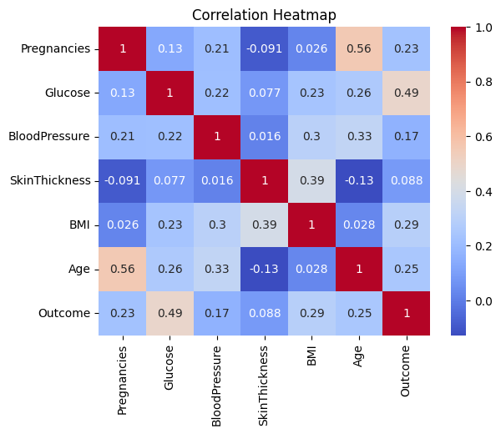
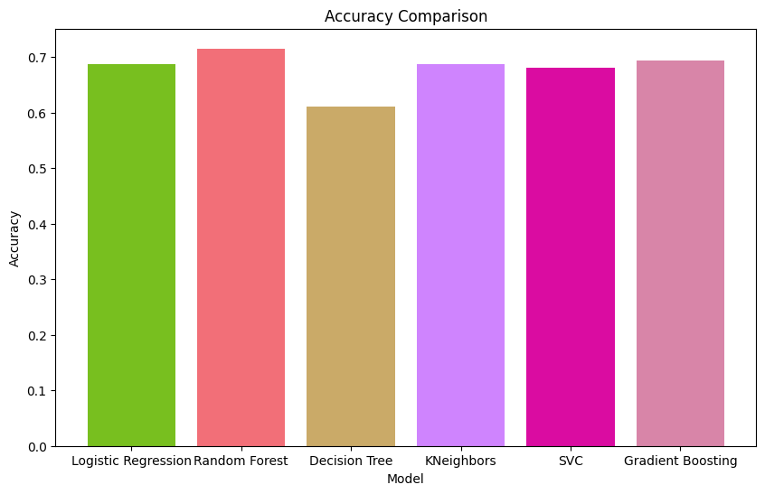
Result Analysis
10
68.75%
71.53%
68.75%
69.44%
68.06%
61.11%
Fig - Heatmap
Fig – Accuracy Graph

Slide 15
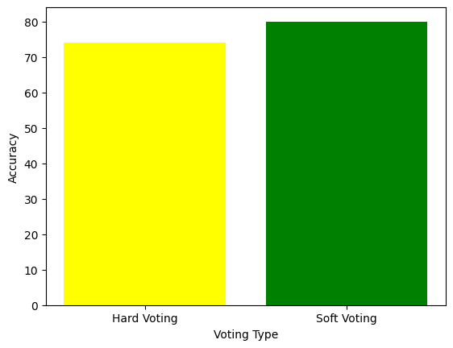
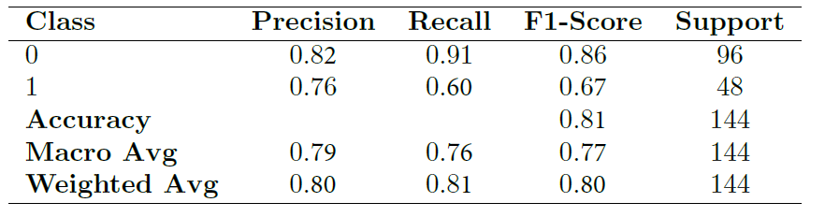
Result Analysis
11
Ensemble Method:
Hard Voting – 74% Accuracy
Soft Voting – 81% Accuracy
81%
74%
Table – Classification Report
Fig – 2 types of voting

Slide 16
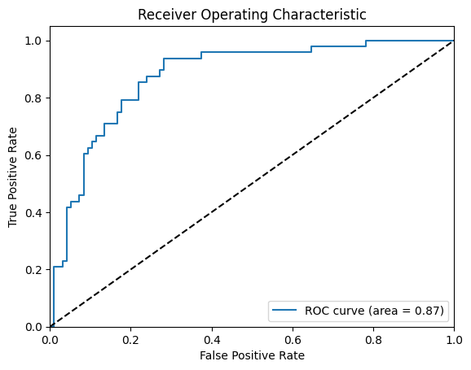
Result Analysis
12
Fig – ROC Curve

Slide 17
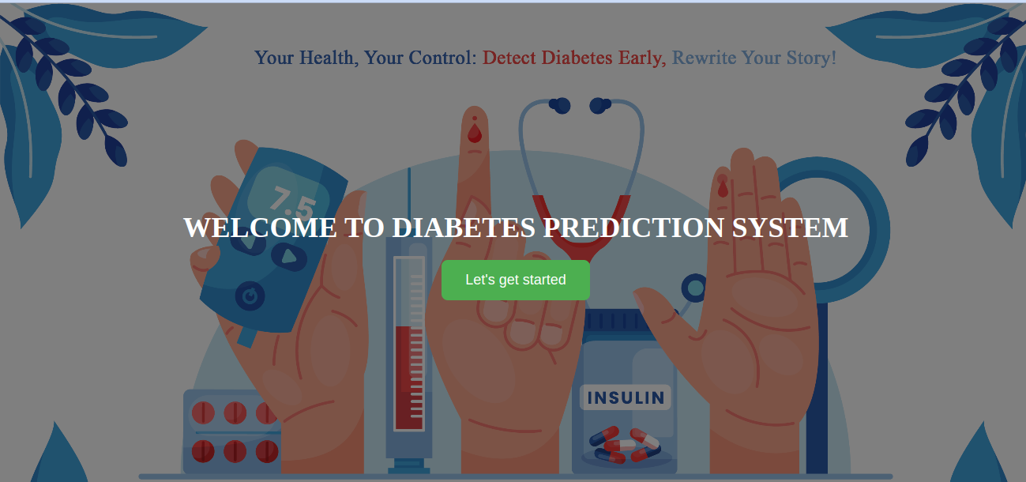
Result Analysis
13
2. Front-End:
Fig – Welcome Page

Slide 18
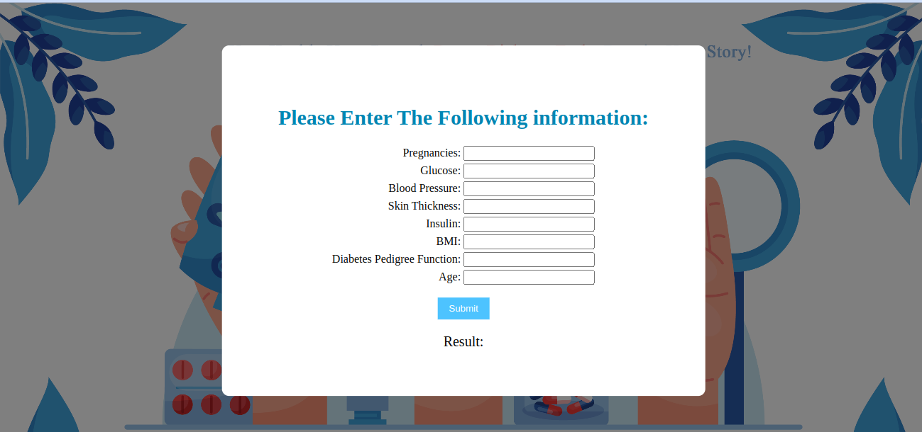
Result Analysis
14
Fig – Homepage

Slide 19

Result Analysis
15
Fig – Error in Input Filed

Slide 20
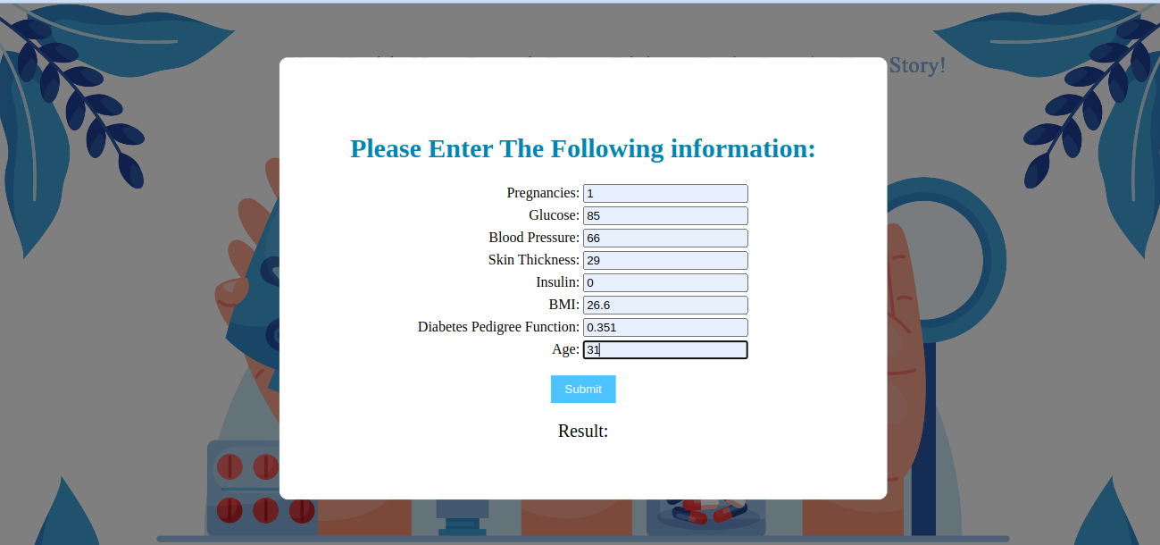
Result Analysis
16
Fig – Providing User Information 01

Slide 21
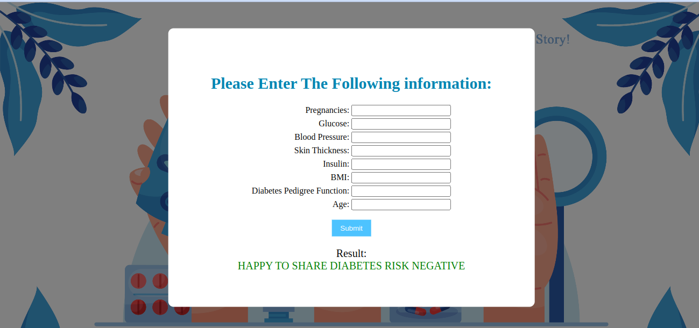
Result Analysis
17
Fig – Result 1: Negative

Slide 22
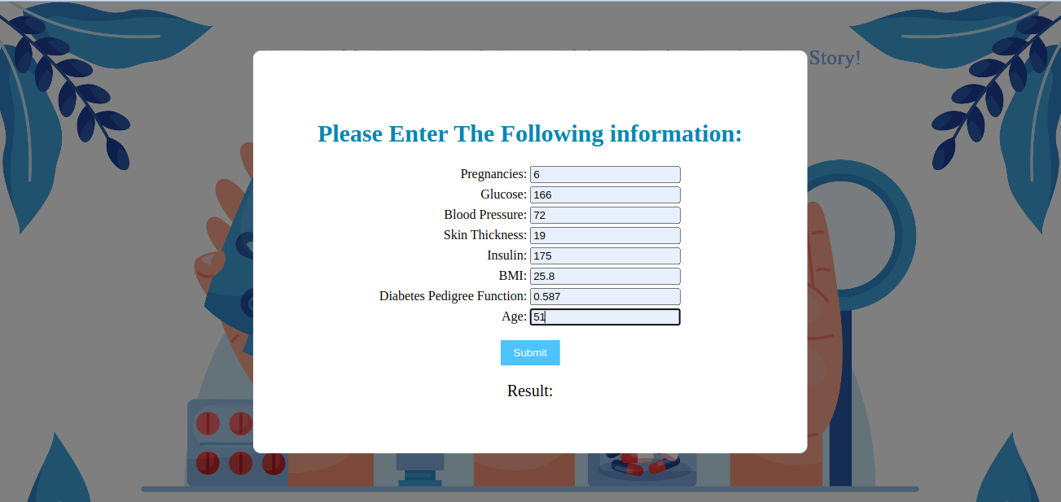
Result Analysis
18
Fig – Providing User Information 02

Slide 23

Result Analysis
19
Fig – Result 2: Positive

Slide 24
20
Conclusion & Future Work
The diabetes prediction system using machine learning is a promising approach for early detection and treatment of diabetes.
It accurately predicts the likelihood of developing diabetes based on medical history
and lifestyle factors
Will shift to live server
Design a Mobile Application so that people can access it from multiple devices.

Slide 25
21
Reference
[1] Khanam, J. J., \& Foo, S. Y. (2021). A comparison of machine learning algorithms for diabetes prediction. Ict Express, 7(4), 432-439.
[2] Patel, S. (2021). Predicting a risk of diabetes at early stage using machine learning approach. Turkish Journal of Computer and Mathematics Education (TURCOMAT), 12(10), 5277-5284.
[3] Xue, J., Min, F., \& Ma, F. (2020, November). Research on diabetes prediction method based on machine learning. In Journal of Physics: Conference Series (Vol. 1684, No. 1, p. 012062). IOP Publishing
[4] Rajeswari, M., \& Prabhu, P. (2019). A review of diabetic prediction using machine learning techniques. International Journal of Engineering and Techniques, 5(4), 2395-1303.

Slide 26
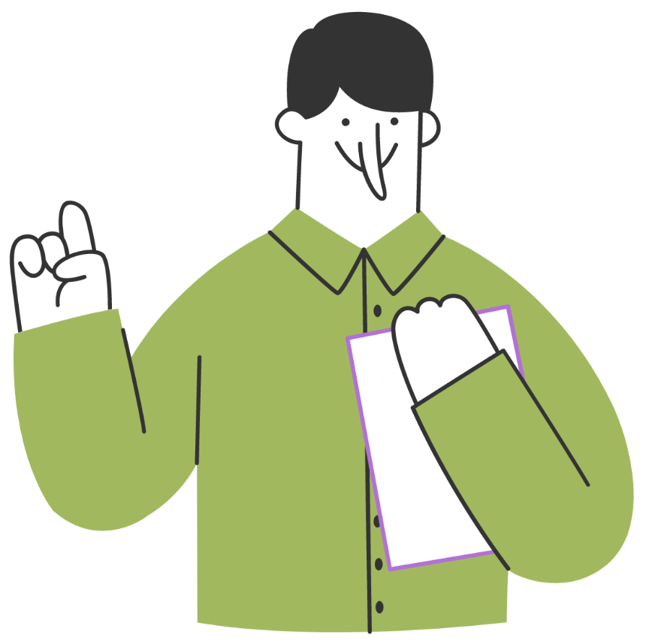
Thank you!

